Slide 1

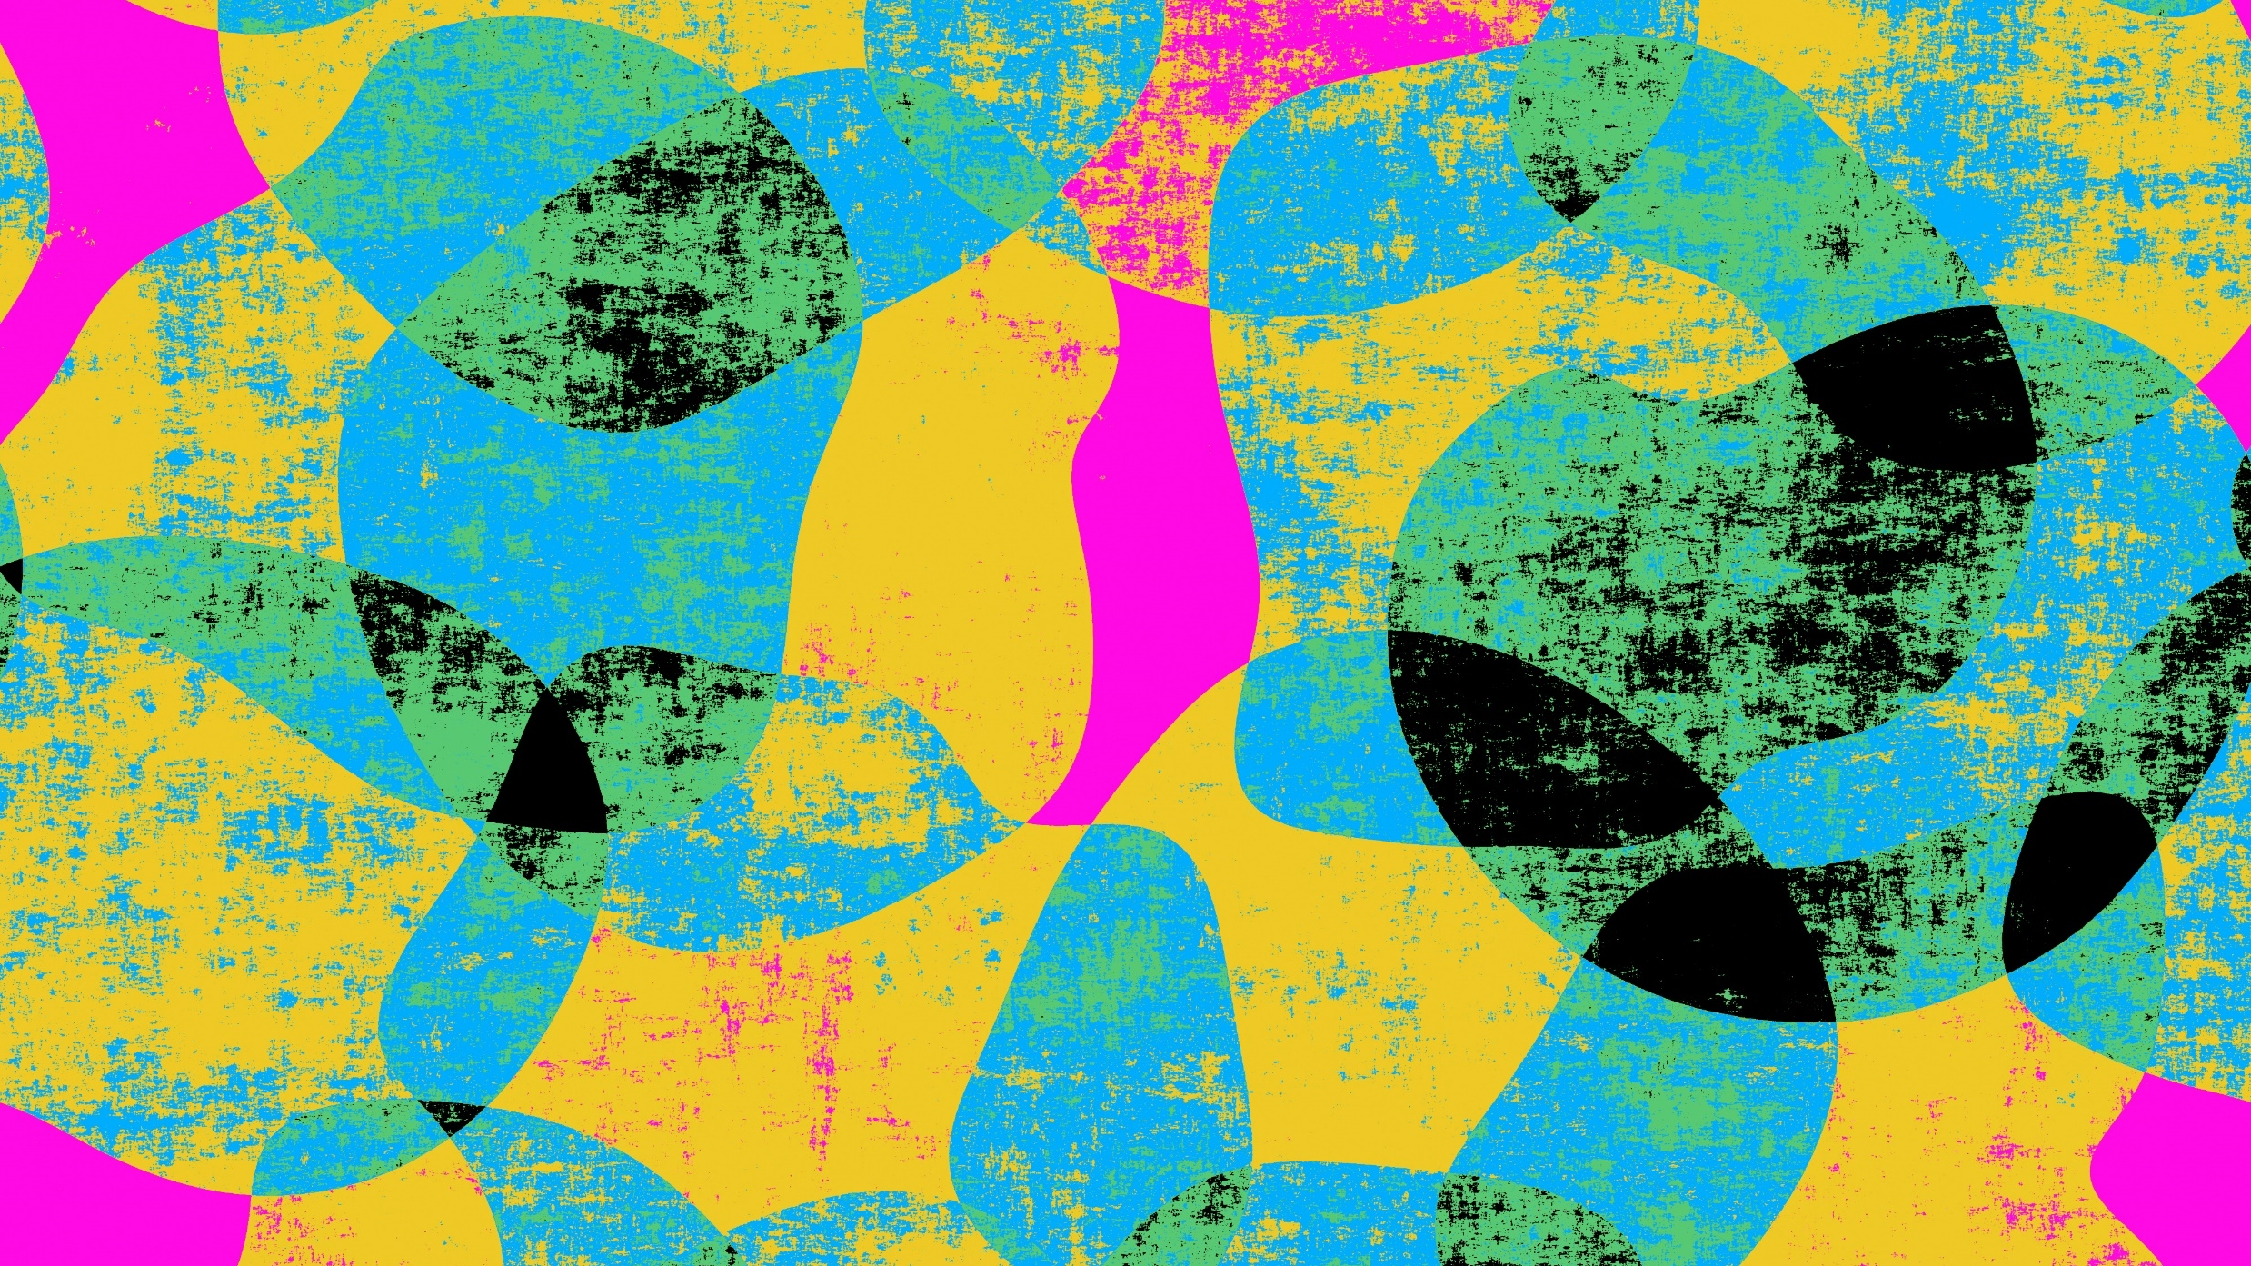

Rock paper scissor ✊ 🧻 ✂️
Name:Thatha.Archana Bhavani
SubtitleThe Ultimate Hand Game Showdown
Organisation: Micro IT
Topic :rock paper scissor

Slide 2
🔍 Abstract
This project is a simple interactive Rock Paper Scissors game implemented using HTML, CSS, and JavaScript. The game provides a user-friendly interface where players can select one of three choices: Rock (🪨), Paper (📄), or Scissors (✂️). Upon selection, the computer randomly chooses its move, and the result (win, lose, or draw) is displayed along with updated scores.
Key Features:
Responsive buttons with visual cues and hover effects.
Real-time result display based on game logic.
Score tracking for both the player and the computer.
Clean, modern UI with a centered layout and intuitive design.
This mini-project demonstrates basic event handling, conditional logic, and DOM manipulation, making it an excellent beginner-level example of interactive web development.

Slide 3
Introduction
What is Rock, Paper, Scissors?
A simple hand game played between two people
Each player chooses one of three options: Rock, Paper, or Scissors
Often used to settle disputes or just for fun!
Where is it played?
Rock, Paper, Scissors is a hand game that can be played:
Anywhere, since it requires no equipment — just two players using hand gestures.
Commonly played in person as a quick decision-making tool (like flipping a coin).
It can also be played online or through apps and video games.
Why is it fun?
Rock, Paper, Scissors is fun for a few key reasons:

Slide 4
Simplicity: The rules are easy to learn — anyone can play instantly, regardless of age or language.
Fast-paced: Each round takes only a few seconds, making it perfect for quick matches or settling decisions on the spot.
Unpredictability: Since it's based on guessing and psychology, there’s suspense in trying to outsmart your opponent.
Competition: Even though it’s simple, there's still a winner and loser, which adds excitement.
Mind games: Advanced players enjoy the psychological battle — predicting patterns, bluffing, or baiting choices.
It’s a mix of chance, skill, and fun mind play, all packed into a few seconds — that’s what makes it enjoyable.

Slide 5
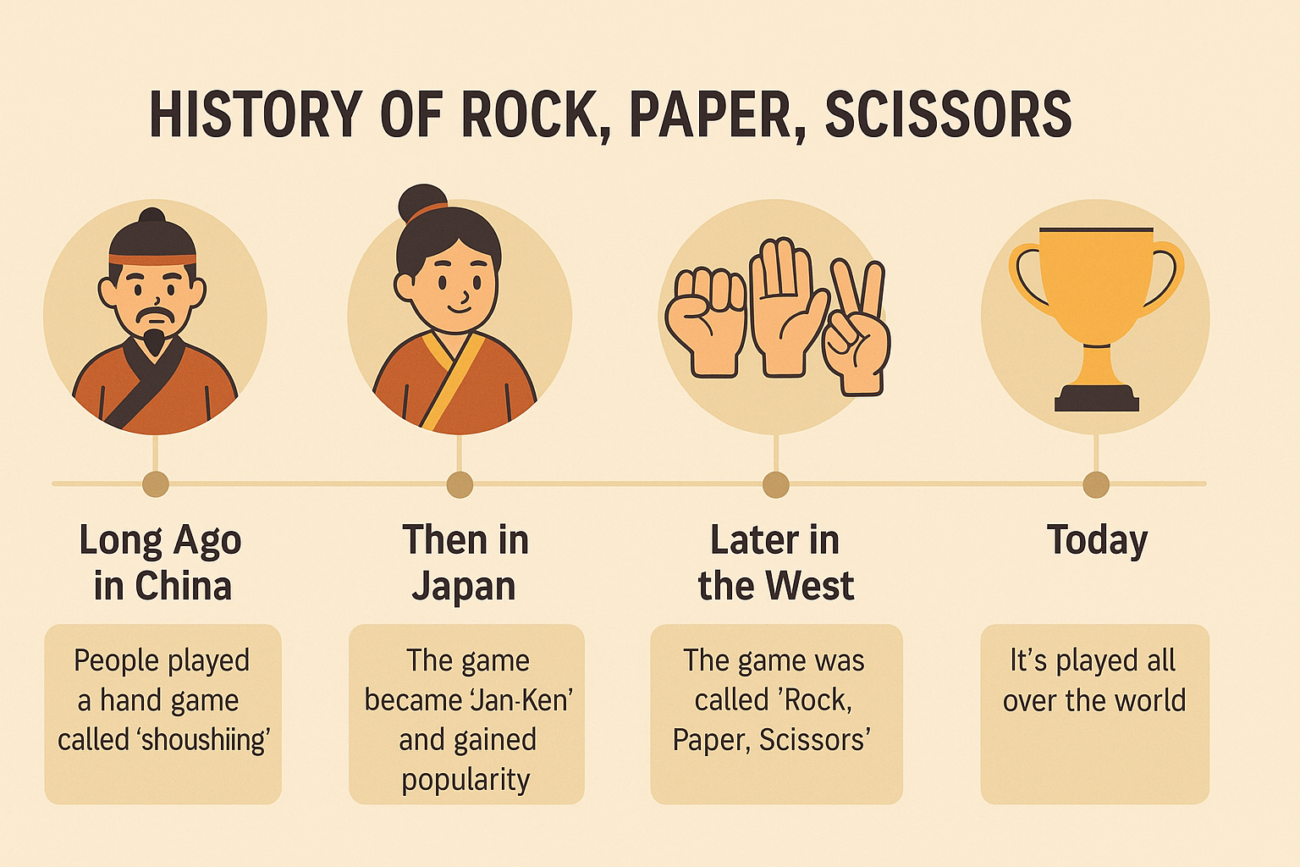
History of game
🐉 Long ago in China (about 2,000 years ago)
People played a hand game called "shoushiling" to help make decisions or just for fun.
🇯🇵 Then in Japan (about 400 years ago)
The game changed a bit and became "Jan-Ken", using the hand signs we know today:
Rock (fist)
Paper (open hand)
Scissors (two fingers)
It became very popular with kids and adults.
🌍 Later in the West (about 100 years ago)
The game spread to Europe and America.
People started calling it Rock, Paper, Scissors.
It became a fun way to settle arguments or choose who goes first.

Slide 6
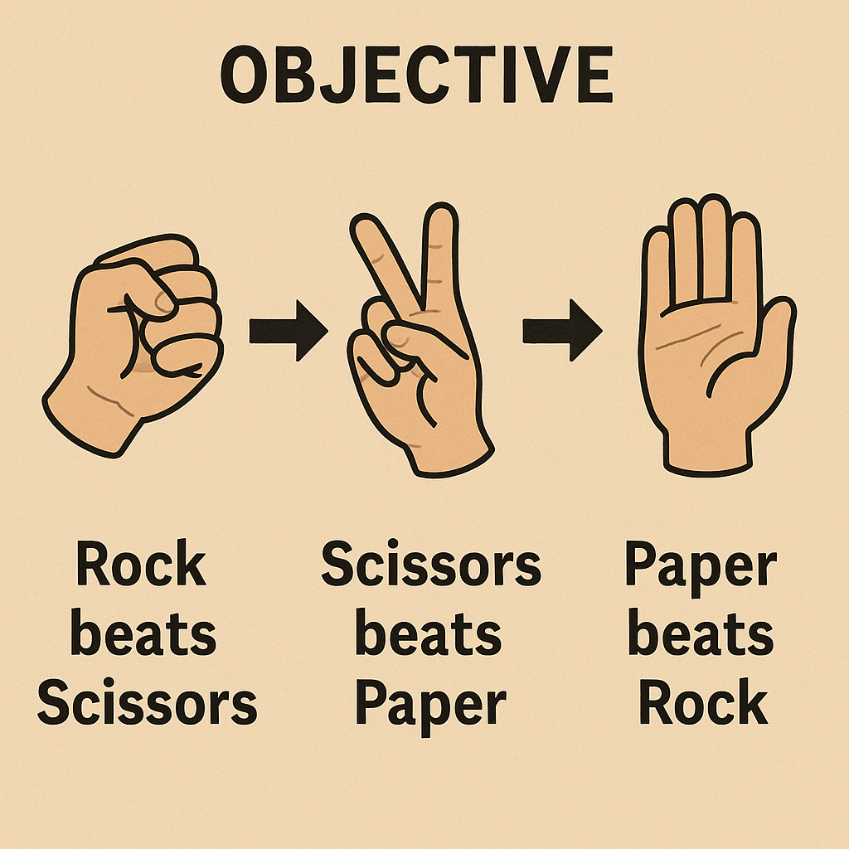
Objective of rock paper scissor
The objective of Rock, Paper, Scissors is simple:
👉 To beat your opponent by choosing a hand sign that wins against theirs.
Here’s how it works:
Rock beats Scissors (Rock crushes Scissors)
Scissors beats Paper (Scissors cuts Paper)
Paper beats Rock (Paper covers Rock)
If both players choose the same sign, it’s a tie and you play again.
It’s often used to:
Decide who goes first
Settle arguments
Just have fun!

Slide 7
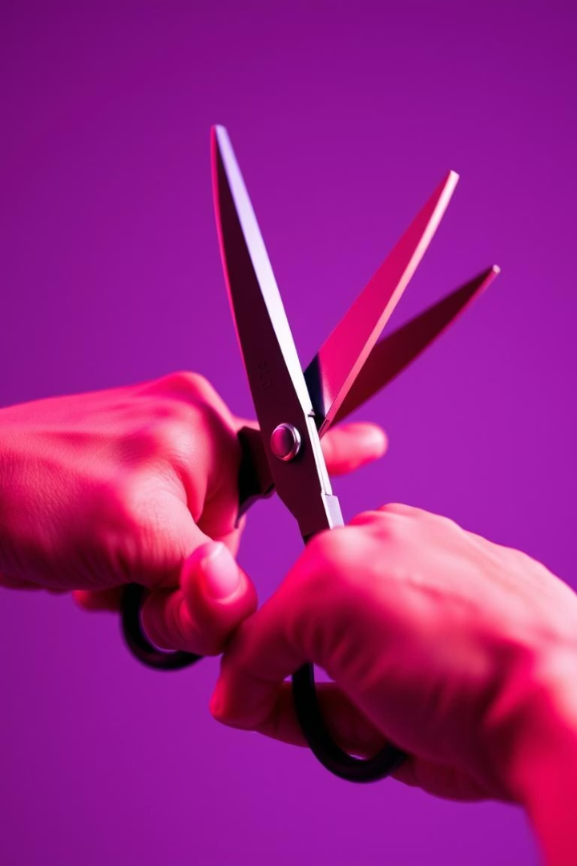
Rules of rock paper scissor
Gestures:
Rock (a closed fist)
Paper (an open hand)
Scissors (a fist with index and middle fingers extended, forming a V)
Rules:
Rock beats Scissors (Rock crushes Scissors)
Scissors beats Paper (Scissors cut Paper)
Paper beats Rock (Paper covers Rock)
If both players choose the same gesture, it's a tie.

Slide 8

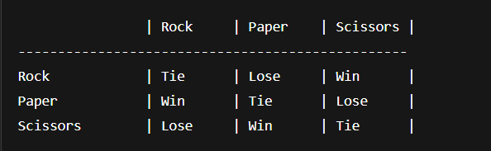
Visual outcome chart:
Rock → Scissors Scissors → Paper Paper → Rock

Slide 9

How to Play
Count: "Rock, Paper, Scissors, Shoot!"
Reveal your choice
Compare outcomes
Celebrate or try again!

Slide 10
Game in Action
Step-by-step walkthrough of a round
Example: You pick Rock, friend picks Scissors → You win

Slide 11

Strategy Tips
Play unpredictably (Randomize!) Don’t fall into patterns. Humans are bad at being truly random, so mix it up consciously.
Observe opponent tendencies People often start with Rock. Beginners especially do this, so consider starting with Paper.
Use the "Win-Stay, Lose-Shift" principle Many players unconsciously follow this:
If they win, they repeat the same move.
If they lose, they switch to the move that would beat the one you just used.
Counter expected behavior If you notice your opponent follows a pattern (e.g., always goes Rock after losing), pre-counter it.

Slide 12
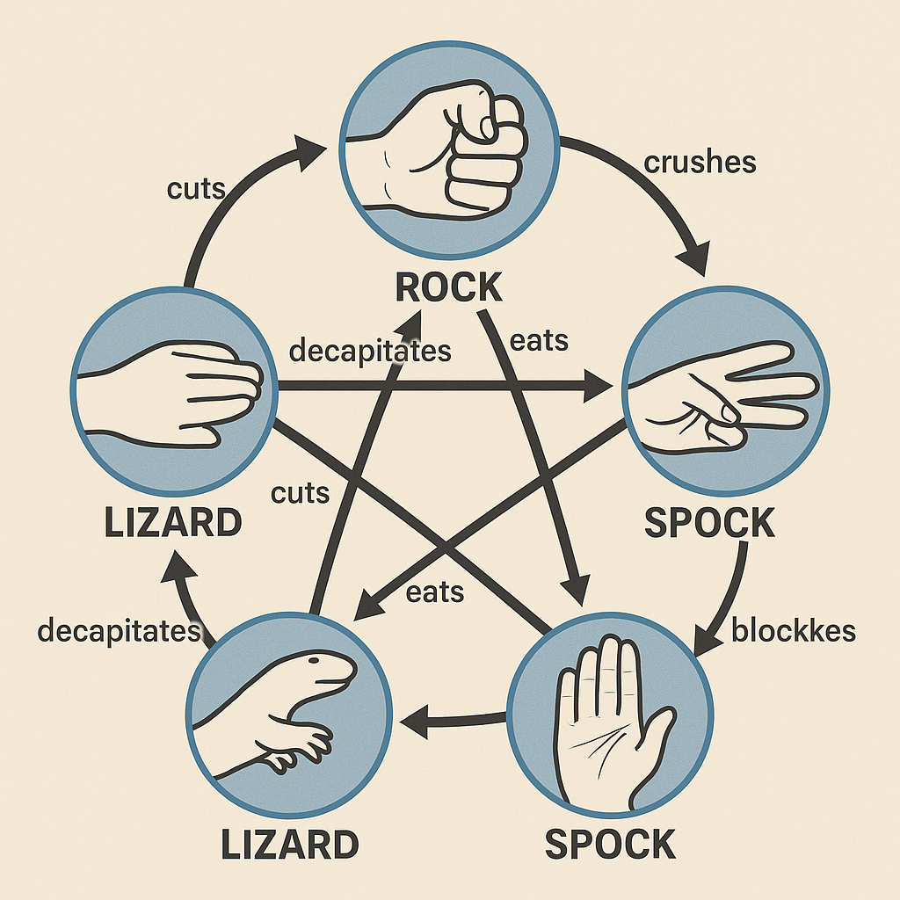
Fun Variations:
🖐️ 1. Rock, Paper, Scissors, Lizard, Spock
Made popular by The Big Bang Theory, this version adds two new gestures:
Expanded Rules:
Scissors cuts Paper
Paper covers Rock
Rock crushes Lizard
Lizard poisons Spock
Spock smashes Scissors
Scissors decapitates Lizard
Lizard eats Paper
Paper disproves Spock
Spock vaporizes Rock
Rock crushes Scissors
🧠 Harder to predict = more fun.
Rock, Paper, Scissors, Lizard, Spock

Slide 13
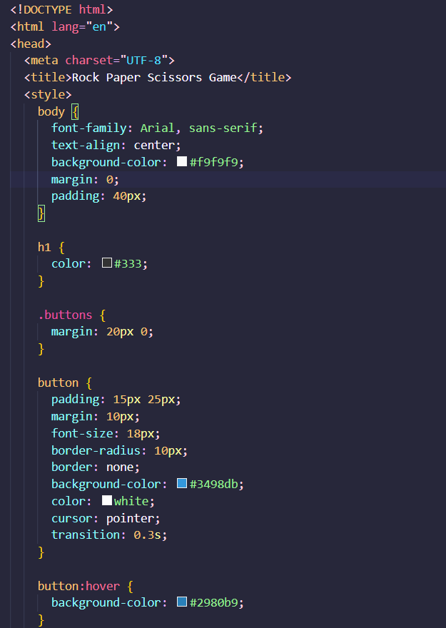
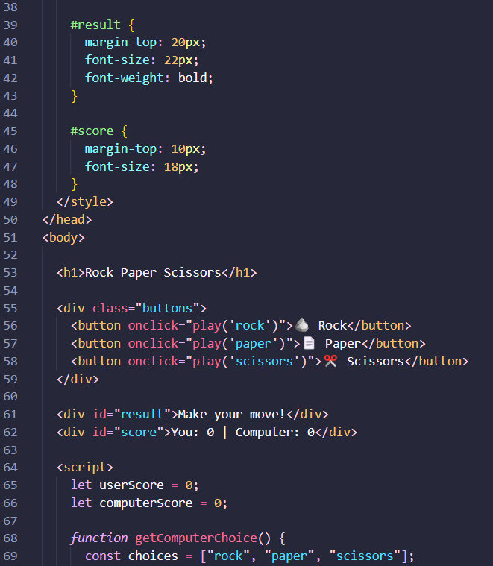
Code

Slide 14
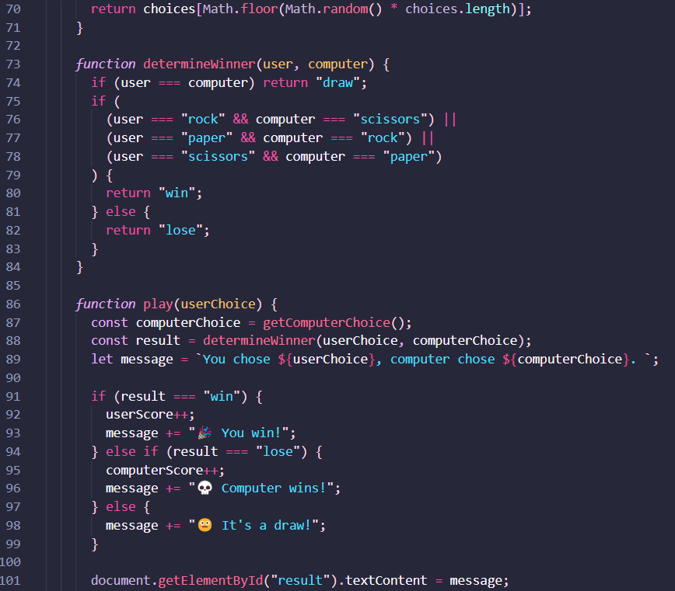
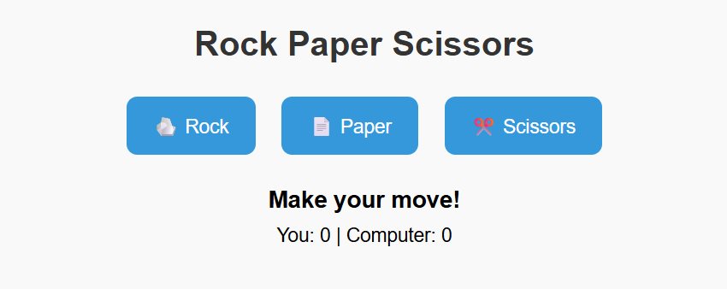
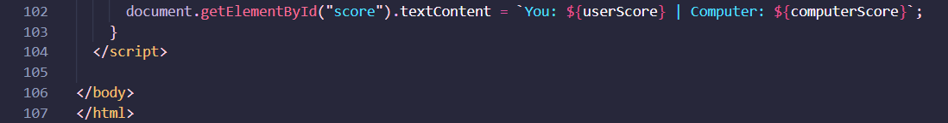
Output:

Slide 15
Thank you

